Slide 1
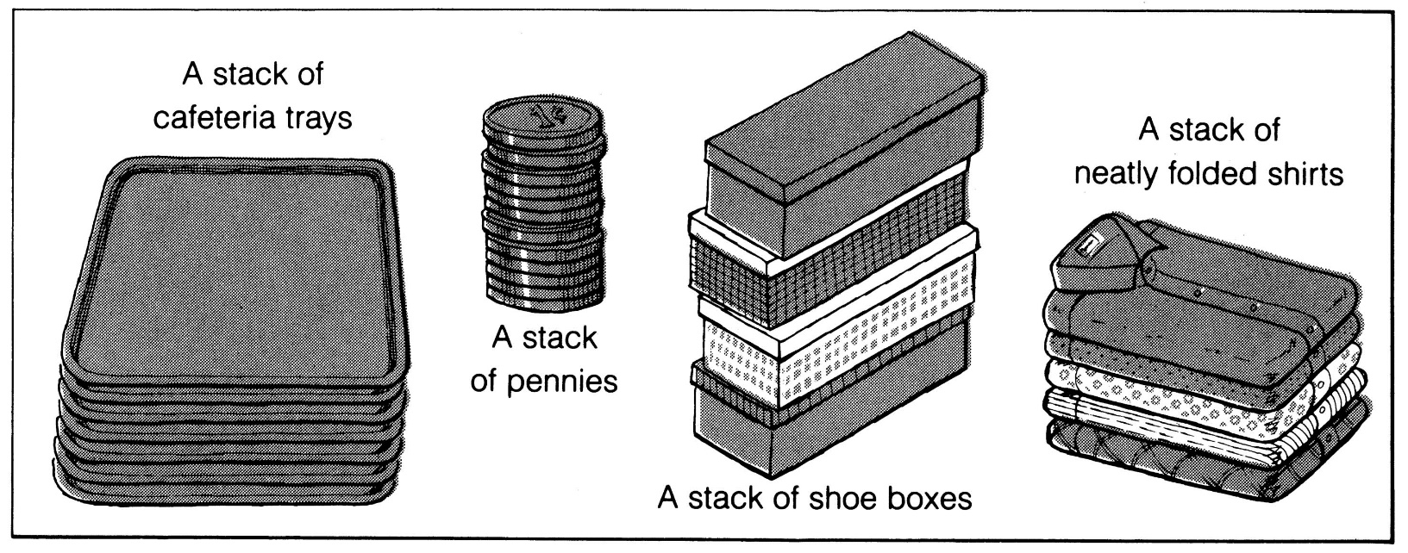
What is a stack?
It is an ordered group of homogeneous items of elements.
Elements are added to and removed from the top of the stack (the most recently added items are at the top of the stack).
The last element to be added is the first to be removed (LIFO: Last In, First Out).

Slide 2
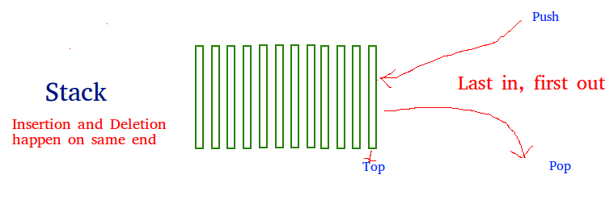
STACK
Stack is a linear data structure which follows a particular order in which the operations are performed.
The order may be LIFO(Last In First Out) or FILO(First In Last Out).

Slide 3
Stack as ADT
A Stack contains elements of same type arranged in sequential order.
All operations takes place at a single end that is top of the stack and following operations can be performed:
push() – Insert an element at one end of the stack called top.
pop() – Remove and return the element at the top of the stack, if it is not empty.
peek() – Return the element at the top of the stack without removing it, if the stack is not empty.
size() – Return the number of elements in the stack.
isEmpty() – Return true if the stack is empty, otherwise return false.
isFull() – Return true if the stack is full, otherwise return false.

Slide 4
#include <iostream>
using namespace std;
#define MAX 1000
class Stack {
int top;
public:int a[MAX]; // Maximum size of Stack
Stack() { top = -1; }
void push(int);
int pop();
int peek();
void display();
bool isEmpty();
};

Slide 5
void Stack::push(int x)
{
if (top >= (MAX - 1)) {
cout << "Stack Overflow";
}
else {
a[++top] = x;
cout << x << " pushed into stack\n";
}
}

Slide 6
int Stack::pop()
{
if (top < 0) {
cout << "Stack Underflow";
return 0;
}
else {
int x = a[top--];
return x;
}
}

Slide 7
int Stack::peek()
{
if (top < 0) {
cout << "Stack is Empty";
return 0;
}
else {
int x = a[top];
return x;
}
}

Slide 8
bool Stack::isEmpty()
{
return (top < 0);
}
void Stack::display() {
if(top>=0) {
cout<<"Stack elements are:";
for(int i=top; i>=0; i--)
cout<<a[i]<<" ";
cout<<endl;
} else
cout<<"Stack is empty";}

Slide 9
int main()
{
Stack s;
s.push(10);
s.push(20);
s.push(30);
cout << s.pop() << " Popped from stack\n";
s.display();
cout<<"The element at the top of stack is"<<s.peek();
return 0;
}

Slide 10
Algorithm for checking expression
Scan the expression from left to right.
Whenever a scope opener( ‘(‘,’{‘,’[‘ ) is encountered while scanning the expression, it is pushed to stack.
Whenever as scope ender( ‘)’, ‘}’, ‘]’) is encountered, the stack is examined. If stack is empty, scope ender does not have a matching opener and hence string is invalid. If stack is non empty, we pop the stack and check whether the popped item corresponds to scope ender. If a match occurs, we continue. If it does not, the string is invalid.
4. When the end of string is reached, the stack must be empty; otherwise 1 or more scopes have been opened which have not been closed and string is invalid.

Slide 11
Ex1:(a+b) * (c+d
Ex2:(a+b)*c+d)
(
(
(
(
(a+b)
Pop ‘(‘ since there is ‘)’ & continue
(a+b) *(
Push ‘(‘
(a+b) *(c+d
End of string reached but stack not empty. Hence invalid
push ‘(‘
(
(
push ‘(‘
(a+b)
pop‘(‘ and continue
(a+b)*c+d)
Stack empty when ‘)’ encountered.hence invalid

Slide 12
Ex3: (a+b)*({c*d)
(
(
(
push ‘(‘
(a+b)
pop‘(‘ and continue
(a+b)*(
push‘(‘ and continue
{
{
(
(
(a+b)*({
push ‘{ and continue‘
(a+b)*({c*d)
No match between closing scope ‘)’ and opening scope ‘{‘. Hence invalid.

Slide 13
Ex4: (a+{b*c}+(c*d))
{
(
(
(
(
push ‘(‘ and continue
(a+{
push‘{‘ and continue
(a+{b*c}
pop‘{‘ and continue
(
(
(
(a+{b*c}+(
push ‘( and continue‘
(a+{b*c}+(c*d)
Pop ‘(‘
(a+{b*c}+(c*d))
Pop ‘(‘.
End of string and stack empty. Hence valid

Slide 14
Checking for palindrome
Algorithm
Scan the string from left to right till the end and push every char you encounter during the scan to the stack.
Rescan the string left to right till end and do the following for every char you encounter during scan. Pop one char and compare current char with the popped one.If no match report immediately non palindrome other wise proceed to the next char.

Slide 15
Multiple Stacks

Slide 16
class twoStacks
{
int arr[size];
int top1, top2;
public:
twoStacks() // constructor
{
top1 = -1;
top2 = size;
}

Slide 17
Multiple Stack implementation in single array
// Method to push an element x to stack1
void push1(int x)
{
// There is at least one empty space for new element
if (top1 < top2 - 1)
{
top1++;
arr[top1] = x;
}
else
{
cout << "Stack Overflow";
}
}

Slide 18
// Method to push an element x to stack2
void push2(int x)
{
// There is at least one empty space for new element
if (top1 < top2 - 1)
{
top2--;
arr[top2] = x;
}
else
{
cout << "Stack Overflow";
}
}

Slide 19
// Method to pop an element from first stack
void pop1()
{
if (top1 >= 0 )
{
int x = arr[top1];
top1--;
cout<<“popped element is”<<x;
}
else
{
cout << "Stack UnderFlow";
}
}

Slide 20
// Method to pop an element from second stack
void pop2()
{
if (top2 < size)
{
int x = arr[top2];
top2++;
cout<<“popped element is”<<x;
}
else
{
cout << "Stack UnderFlow";
}
}
};

Slide 21
int main()
{
twoStacks ts;
ts.push1(5);
ts.push2(10);
ts.push2(15);
ts.push1(11);
ts.push2(7);
cout << "Popped element from stack1 is " << ts.pop1();
ts.push2(40);
cout << "\nPopped element from stack2 is " << ts.pop2();
return 0;

Slide 22
Multiple stacks(case n>=3)
#include<iostream>
using namespace std;
#define max_size 20
class stack
{
int top[10];
int a[50];
int boundary[10];
public:
stack(int);
void push(int ,int);
void pop(int);
void display(int);
};
Notes:
https://www.geeksforgeeks.org/efficiently-implement-k-stacks-single-array/

Slide 23
stack::stack(int n)
{
for(int i=0;i<n;i++)
boundary[i]=top[i]=(max_size/n)*i-1;
}

Slide 24
void stack::push(int i,int x)
{
if((top[i]==boundary[i+1])||(top[i]==(max_size-1)))
cout<<"Stack is full \n";
else
a[++top[i]]=x;
}

Slide 25
void stack::pop(int i)
{
if(top[i]==boundary[i])
cout<<"stack is empty\n";
else
cout<<"deleted element is "<<(a[top[i]--]);}

Slide 26
void stack::display(int i)
{
if(top[i]==boundary[i])
cout<<"stack is empty\n";
else
for(int j=top[i];j>boundary[i];j--)
cout<<"\nThe elements of stack are "<<"\n"<<a[j];
}

Slide 27
int main()
{
stack s(5);
s.push(1,10);
s.push(2,30);
s.push(3,40);
s.push(3,28);
s.pop(3);
s.display(2);
return 0;
}

